Slide 1

Input Handling

Slide 2
Learning Objectives
Understand Input Fundamentals
Explore Input Devices
Compare and contrast the Input Manager and Input System
Learn how to handle touch input, accelerometer data, and virtual keyboard input on mobile devices.
Understand the capabilities of Unity's XR Input system

Slide 3
Input
Input in Unity refers to how your game responds to user actions, such as keyboard presses, mouse clicks, or touch gestures. By understanding and effectively using Unity's input systems, you can create interactive and engaging gameplay experiences.

Slide 4
Input
Input devices
Unity supports input from many types of input devices, including:
Keyboards and mice
Joysticks
Controllers
Touch screens
Movement-sensing capabilities of mobile devices, such as accelerometers or gyroscopes
VR and AR controllers
References: https://docs.unity3d.com/2023.2/Documentation/Manual/Input.html

Slide 5
Input
The system support Input in Unity
Unity supports input through two separate systems:
The Input Manager is part of the core Unity platform and available by default.
The Input System is a package that needs to be installed via the Package Manager before you can use it. It requires the .NET 4 runtime, and doesn’t work in projects that use the old .NET 3.5 runtime.
References: https://docs.unity3d.com/2023.2/Documentation/Manual/Input.html

Slide 6
Input
Unity offers two primary input systems:
1. Input Manager:
A legacy system, still functional but less flexible than the newer Input System.
Relies on predefined input axes and buttons.
Suitable for simple input scenarios.
2. Input System:
A modern, flexible input system.
Supports a wide range of input devices and platforms.
Allows for custom input actions and bindings.
Ideal for complex input setups and advanced input handling.
References: https://docs.unity3d.com/2023.2/Documentation/Manual/Input.html

Slide 7
Input System
What is the Input System?
The Unity Input System is a powerful and flexible system for handling input in your games and applications. It provides a unified way to manage input from various devices, including:
Keyboard and Mouse
Gamepads and Joysticks
Touchscreens
XR Devices
References: https://docs.unity3d.com/Packages/com.unity.inputsystem@1.11/manual/index.html

Slide 8
Input System
Key Features:
Input Actions: Define and customize input actions, such as button presses, axis movements, and touch gestures.
Input Controls: Map input actions to specific input devices.
Input Devices: Support for a wide range of input devices, including custom devices.
Rebinding: Allow players to remap controls to their preferred input devices.
State-Based Input: Handle continuous input states, such as holding down a button.
Event-Based Input: Trigger events when specific input actions occur.
References: https://docs.unity3d.com/Packages/com.unity.inputsystem@1.11/manual/index.html

Slide 9
Input System
Key Concepts:
Input Actions: Represent user actions like pressing a button, moving a joystick, or touching the screen.
Input Controls: Define how input actions are mapped to specific input devices (keyboard, mouse, gamepad, etc.).
Action Maps: Organize input actions into logical groups based on different game states or contexts.
References: https://docs.unity3d.com/Packages/com.unity.inputsystem@1.11/manual/index.html

Slide 10
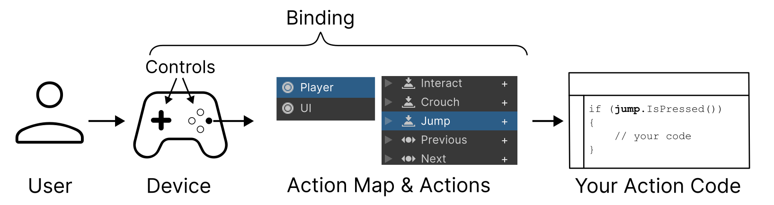
Input System
How It Works:
User Input: The user interacts with an input device (e.g., keyboard, gamepad, touchscreen).
Input System: The system captures the input and maps it to the corresponding input action.
Action Triggered: The input action is triggered, and the associated code in your script is executed.
References: https://docs.unity3d.com/Packages/com.unity.inputsystem@1.11/manual/Concepts.html

Slide 11
Input System
Input System Workflows:
There are multiple ways to use the Input System, however the primary and recommended workflow is to use the Input Actions panel in the Project Settings window to configure your project-wide Actions and Bindings, get references to those Actions in your code's Start method, then read the values for those actions in your Update method.
Main workflows of Input System:
Using Actions
Using Action and the PlayerInput Component
Directly read device states
References: https://docs.unity3d.com/Packages/com.unity.inputsystem@1.11/manual/Workflows.html

Slide 12
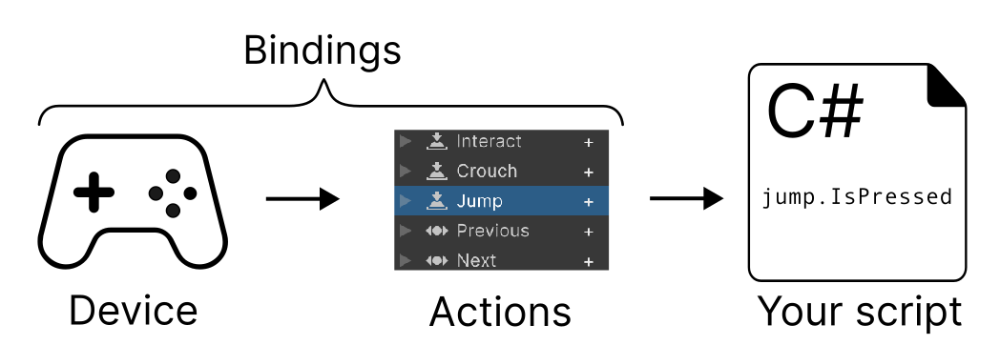
Input System
Input System Workflow – Using Actions (recommended)
Recommended Workflow: Ideal for most scenarios.
Steps:
Define Actions and Bindings: Use the Input Actions window to create input actions and map them to devices.
Reference Actions in Code: Access and read input values using the InputAction class.
Handle Input: Implement game logic based on the input values.
References: https://docs.unity3d.com/Packages/com.unity.inputsystem@1.11/manual/Workflows.html

Slide 13
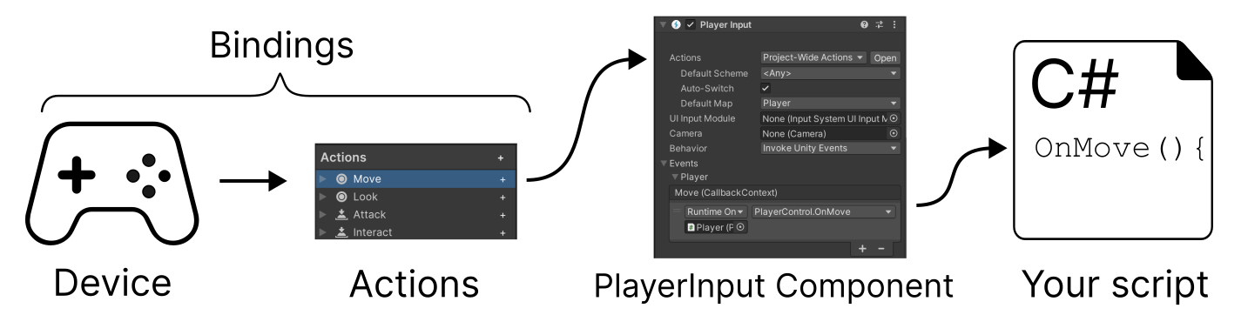
Input System
Input System Workflow – Using Actions and PlayerInput Component
Enhanced Workflow: Provides additional features like device assignment and split-screen.
Steps:
Define Actions and Bindings: As in the previous workflow.
Add PlayerInput Component: Attach the PlayerInput component to a GameObject.
Connect Actions to Callbacks: Use the PlayerInput component to directly connect input actions to event handlers.
References: https://docs.unity3d.com/Packages/com.unity.inputsystem@1.11/manual/Workflows.html

Slide 14
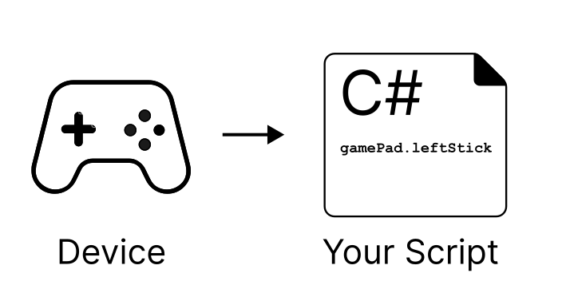
Input System
Directly Reading Device States
Simplified Workflow: Bypasses Actions and Bindings for direct device access.
Steps:
Access Input Devices: Use the InputSystem class to access specific input devices.
Read Device Values: Directly read input values from the devices.
Handle Input: Implement game logic based on the raw input values.z
References: https://docs.unity3d.com/Packages/com.unity.inputsystem@1.11/manual/Workflows.html

Slide 15
Input System
Choosing the Right Workflow:
Actions and Bindings: Best for most scenarios, offering flexibility and customization.
Actions and PlayerInput: Ideal for multiplayer games and advanced input handling.
Direct Device Access: Suitable for simple scenarios or rapid prototyping.
Remember:
The Input System is a powerful tool, but it's important to choose the right workflow for your specific needs.
Start with the recommended workflow (using Actions and Bindings) and explore other options as needed.
Consider using the Input System's features like rebinding controls and device assignment to enhance player experience.
References: https://docs.unity3d.com/Packages/com.unity.inputsystem@1.11/manual/Workflows.html

Slide 16
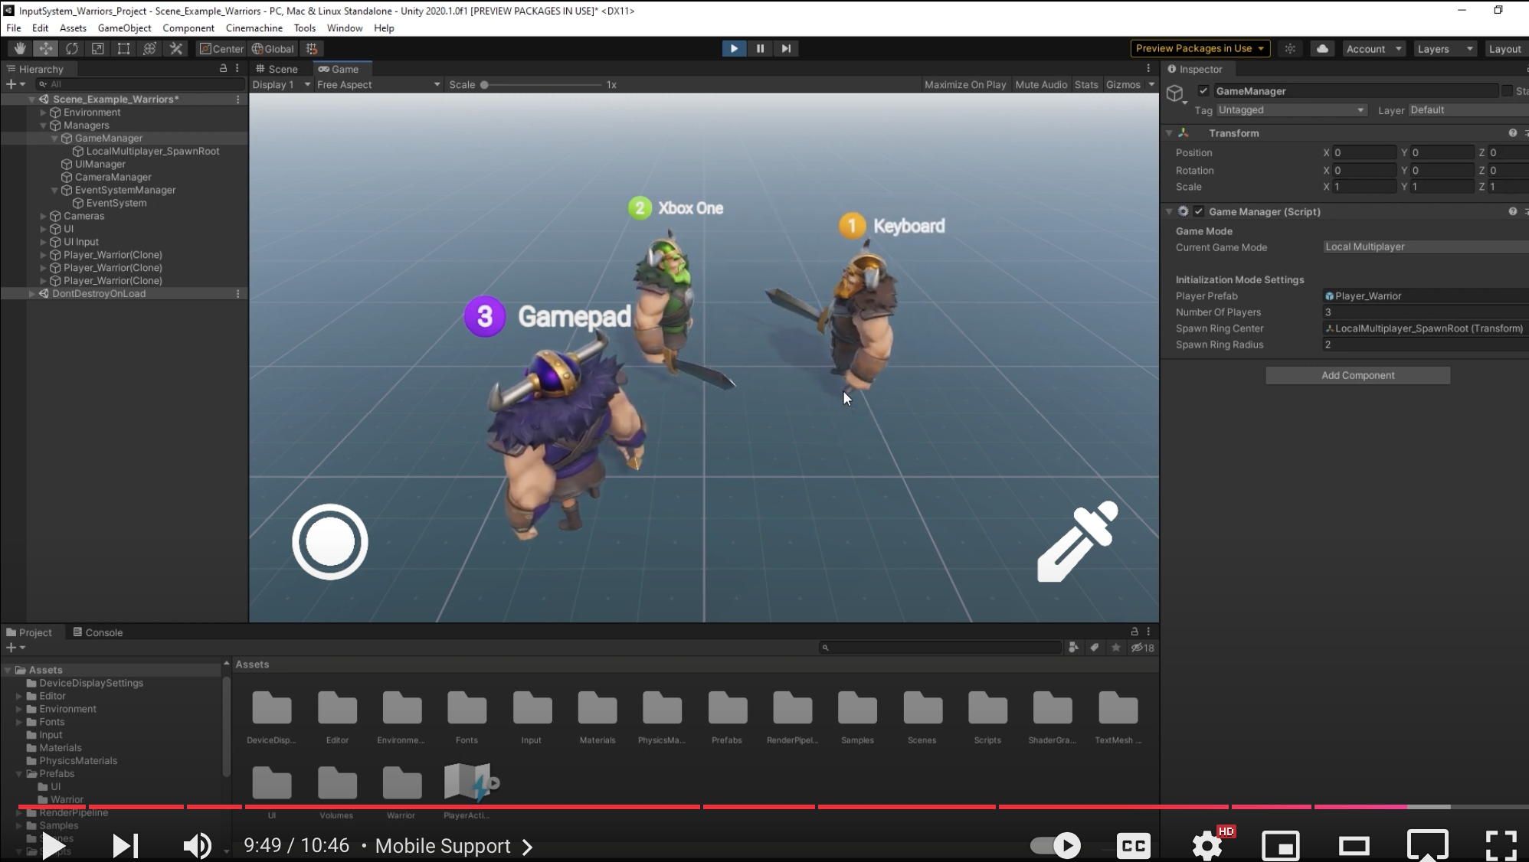
Cameras - Unity Official Tutorials
References: https://www.youtube.com/watch?v=5tOOstXaIKE

Slide 17
Input Manager
How It Works:
Define Axes and Buttons: In the Input Manager window, you can create and configure axes and buttons.
Access Input Values: Use Input.GetAxis() and Input.GetButton() to retrieve input values in your scripts.
Handle Input: Use the input values to control game objects or trigger actions.
References: https://docs.unity3d.com/2023.2/Documentation/Manual/class-InputManager.html

Slide 18
Input Manager
Limitations of the Input Manager:
Limited Flexibility: Less customizable and less flexible than the Input System.
Platform-Specific Issues: Can be challenging to handle input across different platforms.
Difficulty with Complex Input Scenarios: May not be ideal for games with complex input requirements.
References: https://docs.unity3d.com/2023.2/Documentation/Manual/class-InputManager.html

Slide 19
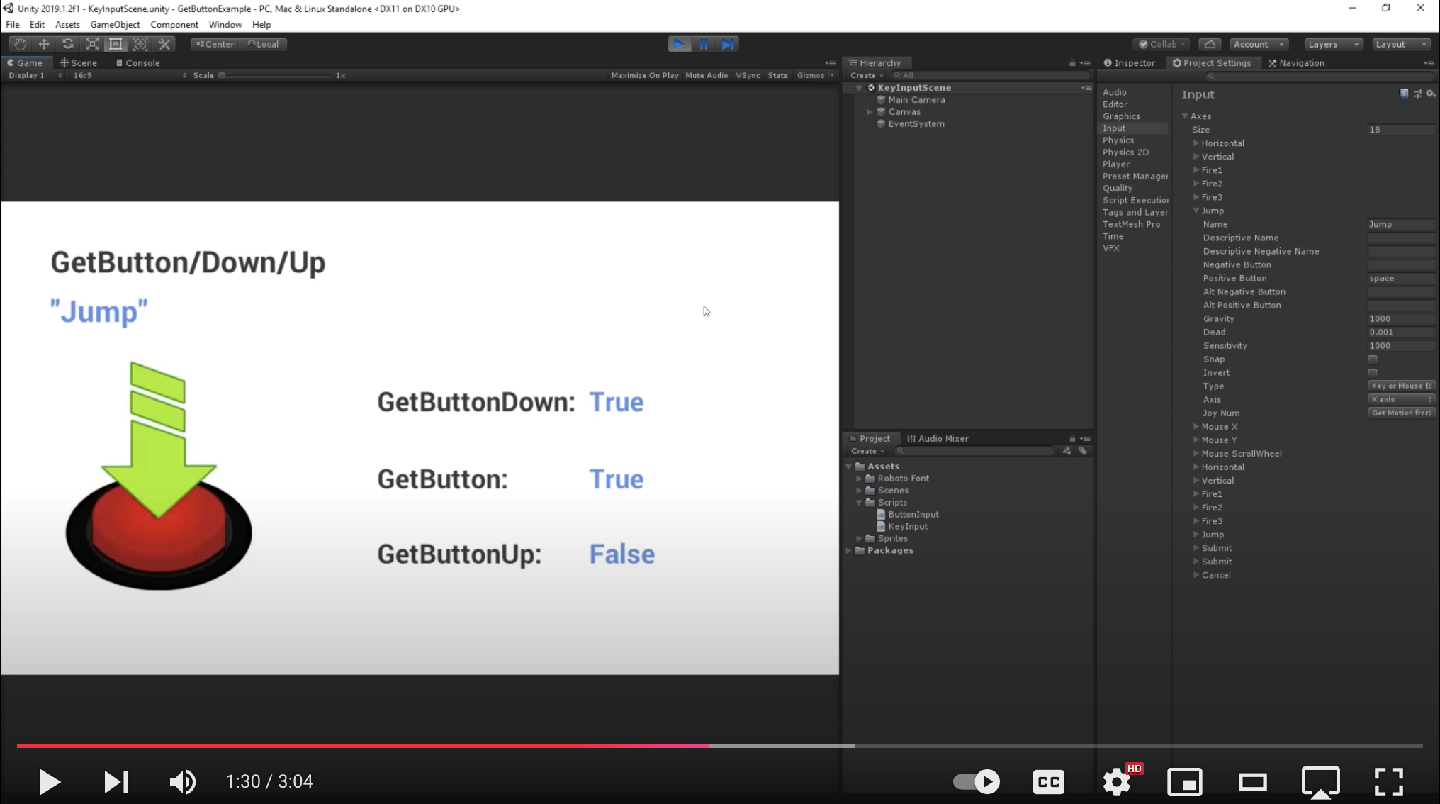
Cameras - Unity Official Tutorials
References: https://www.youtube.com/watch?v=-A7D5Rcumz4

Slide 20
Mobile device input
Touchscreen Input
Unity's Input class provides access to mobile device touchscreens.
iPhones, iPads, and iPod Touches track up to five fingers simultaneously.
Android devices vary but can track two to five fingers.
Each touch is represented by an Input.Touch data structure.
References: https://docs.unity3d.com/2023.2/Documentation/Manual/MobileInput.html

Slide 21
Mobile device input
Touch Data Properties
fingerId: Unique index for a touch.
position: Screen position of the touch.
deltaPosition: Change in screen position since last frame.
deltaTime: Time since the last state change.
tapCount: Number of taps (iOS/iPadOS only).
phase: Describes the touch state (began, moved, stationary, ended, canceled).
References: https://docs.unity3d.com/2023.2/Documentation/Manual/MobileInput.html

Slide 22
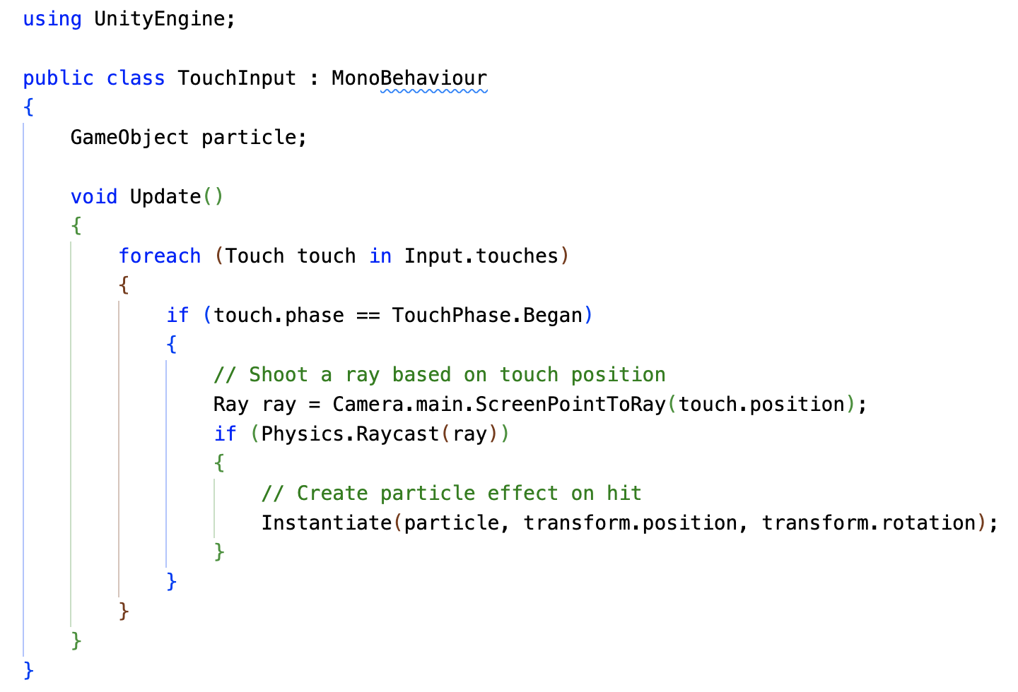
Mobile device input
Example: Shooting a Ray on Tap
References: https://docs.unity3d.com/2023.2/Documentation/Manual/MobileInput.html

Slide 23
Mobile device input
Key Points
Use touch input for native mobile development experiences.
Accelerometer readings are filtered and sampled at 60Hz.
Consider low-pass filtering for smoother accelerometer data.
References: https://docs.unity3d.com/2023.2/Documentation/Manual/MobileInput.html

Slide 24
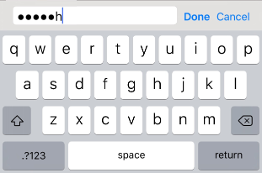
Mobile Keyboard
Mobile Keyboard in Unity
Unity provides a built-in mechanism to display a virtual keyboard on mobile devices, allowing users to input text into your game or application. This is especially useful for games that require user input, such as chat features, level editors, or any other game where the user needs to enter text.
References: https://docs.unity3d.com/2023.2/Documentation/Manual/MobileKeyboard.html

Slide 25
Mobile Keyboard
Key Features:
Automatic Keyboard Display: Unity automatically displays the keyboard when a user taps on an editable GUI element like a text field or password field.
Custom Keyboard Display: You can programmatically show the keyboard using the TouchScreenKeyboard.Open() function.
Keyboard Layout Customization: Choose from various keyboard layouts, including letters, numbers, punctuation, and more.
Secure Text Input: Hide input characters for sensitive information like passwords.
Keyboard Visibility and Size: Control the visibility and size of the keyboard using properties like visible and area.
References: https://docs.unity3d.com/2023.2/Documentation/Manual/MobileKeyboard.html

Slide 26
Unity XR Input
Mobile Keyboard in Unity
Unity's XR Input system provides a powerful and flexible way to handle input from various XR devices, including VR (Virtual Reality) and AR (Augmented Reality) headsets, controllers, and other hardware. This system allows you to create immersive and interactive XR experiences by seamlessly integrating input from different platforms and devices.
References: https://docs.unity3d.com/2023.2/Documentation/Manual/xr_input.html

Slide 27
Unity XR Input
Key Features:
Unified Input API: Provides a consistent interface for accessing input from different XR platforms.
Input Feature Usages: Defines a set of standard input features (e.g., buttons, triggers, joysticks) that can be mapped to specific devices.
Input Device Management: Allows you to query and manage connected XR devices.
Hand Tracking and Eye Tracking: Supports advanced input features like hand tracking and eye tracking.
Haptic Feedback: Provides tactile feedback to enhance user experience.
References: https://docs.unity3d.com/2023.2/Documentation/Manual/xr_input.html

Slide 28
Unity XR Input
Benefits of Using XR Input System:
Platform Independence: Develop XR applications that work across different platforms without significant code changes.
Simplified Input Handling: Streamline input handling with a unified API.
Advanced Input Features: Utilize features like hand tracking and eye tracking to create more immersive experiences.
Customizable Input Mappings: Customize input mappings to suit your specific needs.
References: https://docs.unity3d.com/2023.2/Documentation/Manual/xr_input.html

Slide 29
Recap
Input Fundamentals: We learned that input refers to user actions on devices like keyboards, mice, touchscreens, and controllers. Understanding input is crucial for creating interactive gameplay.
Supported Devices: Unity boasts extensive support for a wide range of input devices, including traditional ones like keyboards and mice, as well as mobile-specific (touchscreens, accelerometers), VR/AR controllers, and even custom devices.
Input Systems: Unity offers two input systems:
Input Manager: A legacy system, suitable for simpler needs, with predefined axes and buttons.
Input System (Recommended): A modern, flexible system ideal for complex scenarios. It allows for custom input actions, bindings, and advanced input handling.

Slide 30
Recap
Input System Key Features:
Actions: Define user interactions like button presses, joystick movements, etc.
Controls: Map input actions to specific devices.
Action Maps: Group actions based on game states or contexts.
Rebinding: Allows players to customize controls.
State-Based/Event-Based Input: Handle continuous or single-time inputs.

Slide 31
Recap
Input System Workflows:
Actions & Bindings (Recommended): Define actions and bindings, access them in code, and handle input based on values.
Actions & PlayerInput Component: Similar to 'Actions & Bindings' but with added features like device assignment and event handler connections.
Direct Device Access: Suitable for simple scenarios or rapid prototyping. Bypass Actions & Bindings for direct interaction with devices.

Slide 32
Recap
Choosing the Right Workflow: The recommended approach is using Actions & Bindings. Explore other options based on project complexity.
Mobile Device Input: Unity provides access to touchscreen input with data like finger position, delta position, and tap count. It also offers a built-in mechanism for displaying a virtual keyboard.
Unity XR Input: This system facilitates handling input from various VR/AR devices. It provides a unified API, simplifies input handling, supports advanced features like hand tracking, and allows customization.

